Slide 1

THE WORD OF
FIRE & HOPE
JEREMIAH
ev / church

Slide 2
Salvation history
The Story So Far
1
Genesis The pattern of the kingdom
Fall, rebellion, and a promise to Abraham
2
Exodus A partial kingdom
Rescue and the Law given, the Golden calf
3
Kings A partial kingdom, divided
Land, king, and temple reach a high point — the kingdom is split in two.

Slide 3
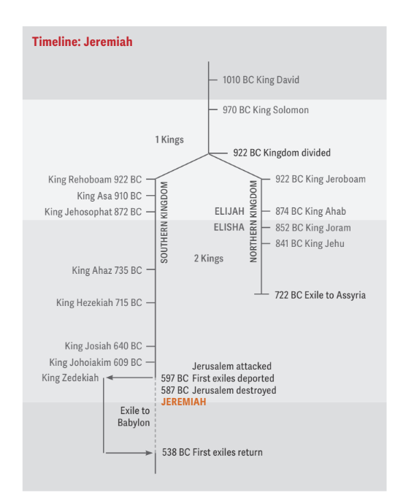
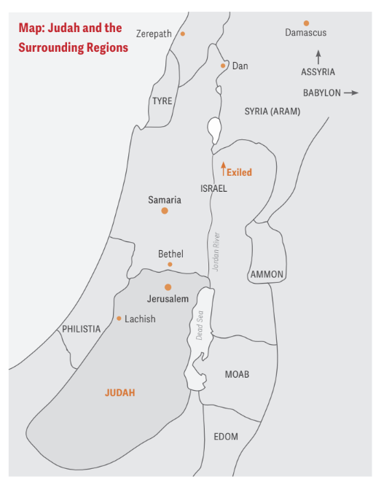
Jeremiah
Dark time
Note: from here on, “Israel” in Jeremiah usually refers to the Northern Kingdom.

Slide 4



Jeremiah 1:1-3
The words of Jeremiah, son of Hilkiah, one of the priests at Anathoth in the territory of Benjamin. The word of the Lord came to him in the thirteenth year of the reign of Josiah son of Amon king of Judah, and through the reign of Jehoiakim son of Josiah king of Judah, down to the fifth month of the eleventh year of Zedekiah son of Josiah king of Judah, when the people of Jerusalem went into exile.
→
→
Josiah
Jehoiakim
Zedekiah
641–609 BC
605–598 BC
597–586 BC

Slide 5

Main theme: The word of God
Jeremiah 1:1–2, 4
1 The words of Jeremiah son of Hilkiah, one of the priests at Anathoth in the territory of Benjamin.
2 The word of the LORD came to him in the thirteenth year…
4 The word of the LORD came to me, saying,

Slide 6
JEREMIAH 1:10
Appointed to Tear Down — and Build
¹⁰ “See, today I appoint you over nations and kingdoms to uproot and tear down, to destroy and overthrow, to build and to plant.”

Slide 7
STRUCTURE OF THE BOOK
Two Movements of the Book
CHAPTERS 2–24
CHAPTERS 25–52
God’s word of fire tears down the idolatrous nation of Judah
God’s word is vindicated among all nations but plants new life

